Slide 1
Ordinary Least Squares (OLS) Regression model for HTC

Slide 2
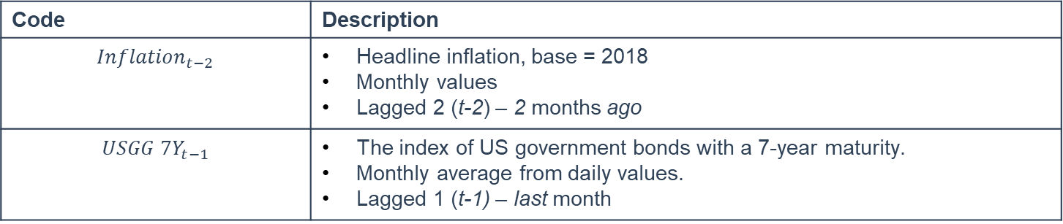
Model (1)
$$BVAL 7Y_{t}=2.53+0.11 {Inflation}_{t−2}+0.88 {USGG 7Y}_{t−1}$$
Code | Description
$${Inflation}_{t−2}$$ | Headline inflation, base = 2018 Monthly values Lagged 2 (t-2) – 2 months ago
$${USGG 7Y}_{t−1}$$ | The index of US government bonds with a 7-year maturity. Monthly average from daily values. Lagged 1 (t-1) – last month
Note: All the variables are multiplied by 100, e.g., 4% = 4
Model passed linear regression assumptions (see Annex for detailed values)
Cochrane-Orcutt procedure was implemented (see Annex for detailed values)

Slide 3
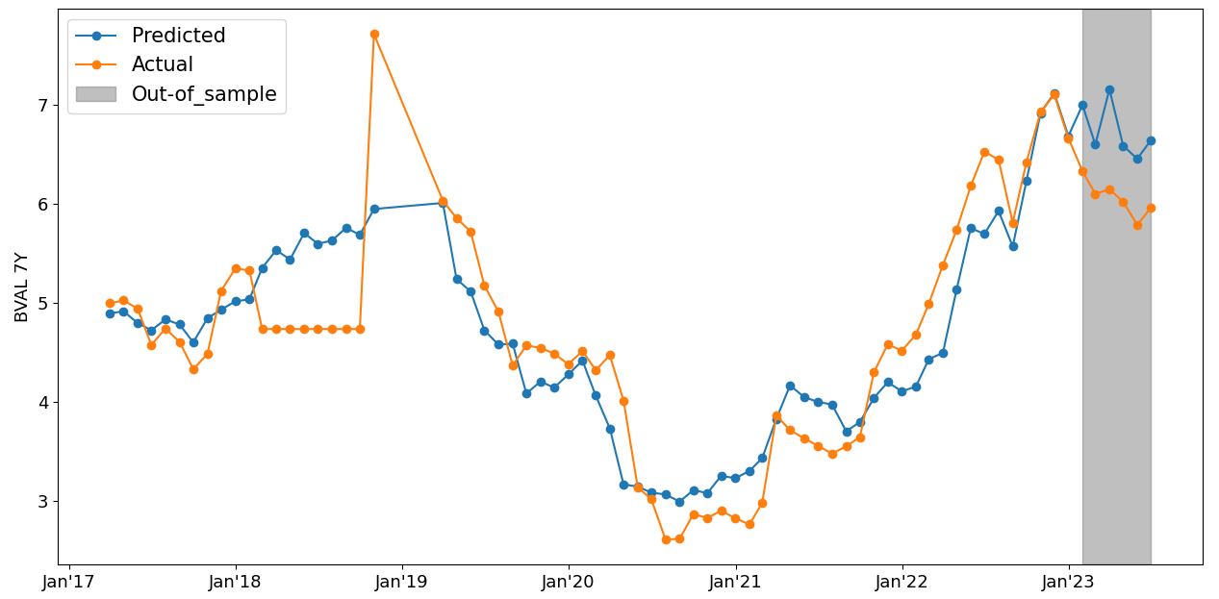
Model (1), Actual vs Predicted
 | MAPE
In-sample | 9.2%
Out-of-sample | 11.4%

Slide 4
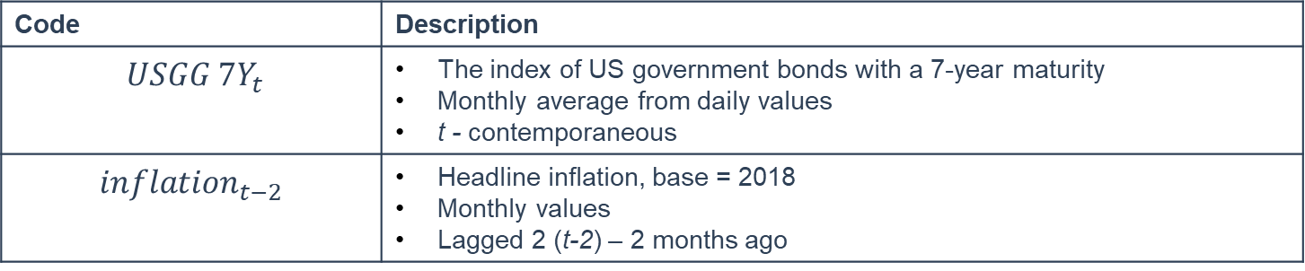
Model (2)
$$BVAL 10Y_{t}=10.51+0.26{ USGG 7Y}_{t}+0.07{Inflation}_{t−2}$$
Code | Description
$${ USGG 7Y}_{t}$$ | The index of US government bonds with a 7-year maturity Monthly average from daily values t - contemporaneous
$$inflation_{t−2}$$ | Headline inflation, base = 2018 Monthly values Lagged 2 (t-2) – 2 months ago
Note: All the variables are multiplied by 100, e.g., 4% = 4
Model passed linear regression assumptions (see Annex for detailed values)
Cochrane-Orcutt procedure was implemented (see Annex for detailed values)

Slide 5
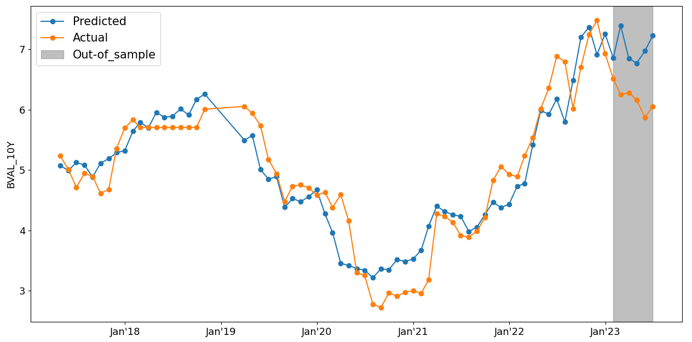
Model (2), Actual vs Predicted
 | MAPE
In-sample | 7.4%
Out-of-sample | 15.1%

Slide 6
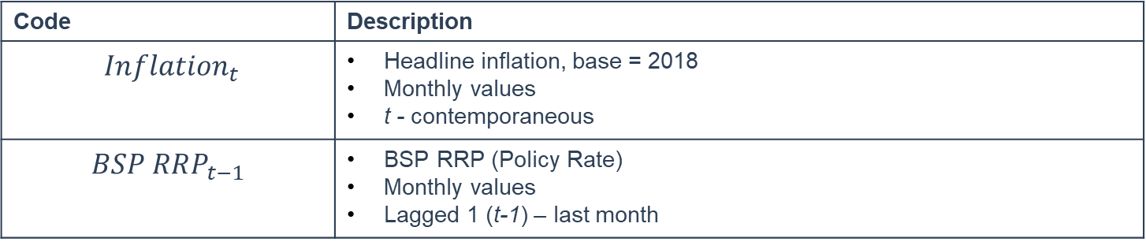
Model (3)
$$BSP RRP_{t}=5.45+0.03{ Inflation}_{t}+0.76 BSP RRP_{t−1}$$
Code | Description
$${ Inflation}_{t}$$ | Headline inflation, base = 2018 Monthly values t - contemporaneous
$$BSP RRP_{t−1}$$ | BSP RRP (Policy Rate) Monthly values Lagged 1 (t-1) – last month
Note: All the variables are multiplied by 100, e.g., 4% = 4
Model passed linear regression assumptions (see Annex for detailed values)
Cochrane-Orcutt procedure was implemented (see Annex for detailed values)

Slide 7
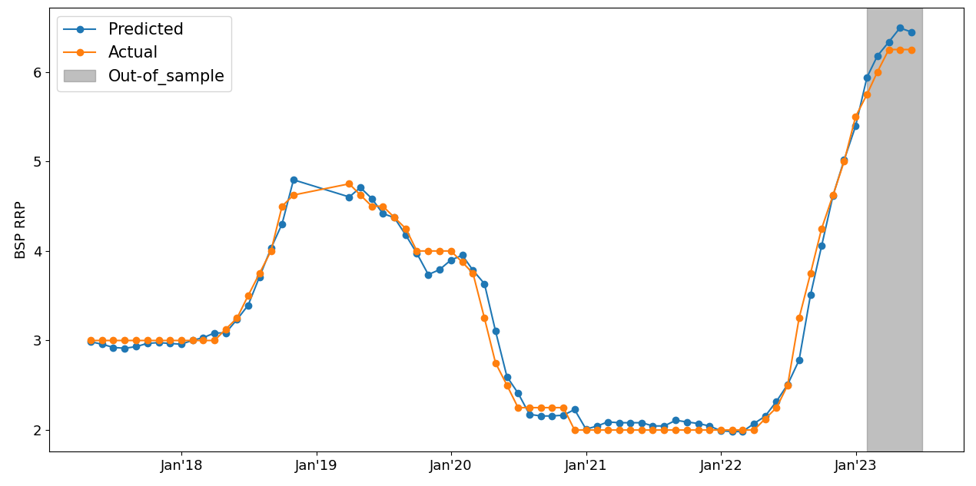
Model (3), Actual vs Predicted
 | MAPE
In-sample | 3.1%
Out-of-sample | 2.8%

Slide 8
Annex

Slide 9
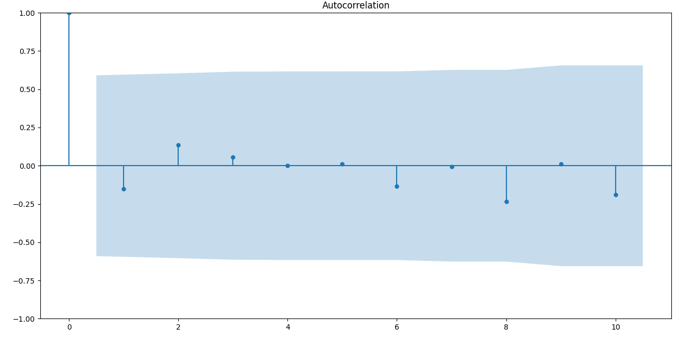
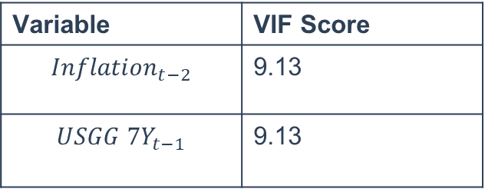
Model (1), Robust check
TEST | Score
Normality – Jarque-Berra test | P-value = 0.39 (Ho = Normal distribution)
Variance – Breusch-Pagan test | P-value = 0.08 (Ho = Constant variance)
Variable | VIF Score
$${Inflation}_{t−2}$$ | 9.13
$${USGG 7Y}_{t−1}$$ | 9.13
Multicollinearity threshold is based on KPMG’s threshold (VIF < 10)

Slide 10
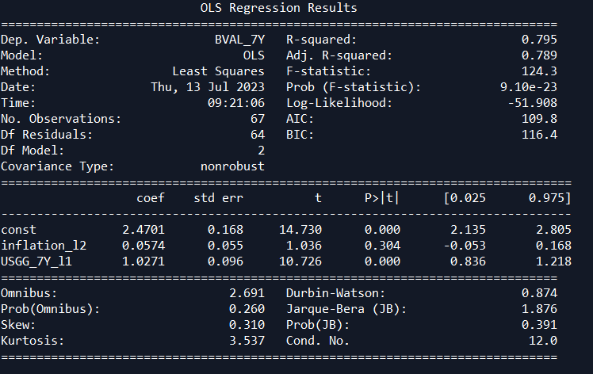
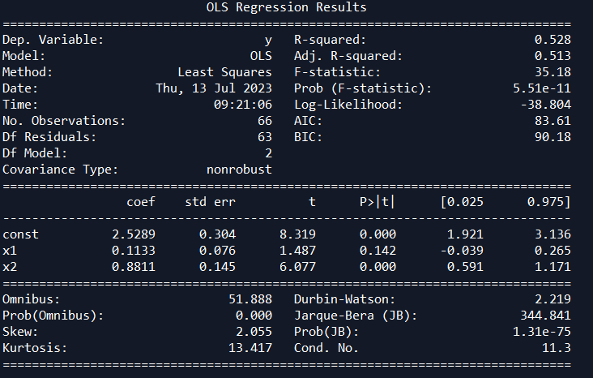
Model (1)
Initial OLS result
OLS result after Cochrane-Orcutt Procedure

Slide 11
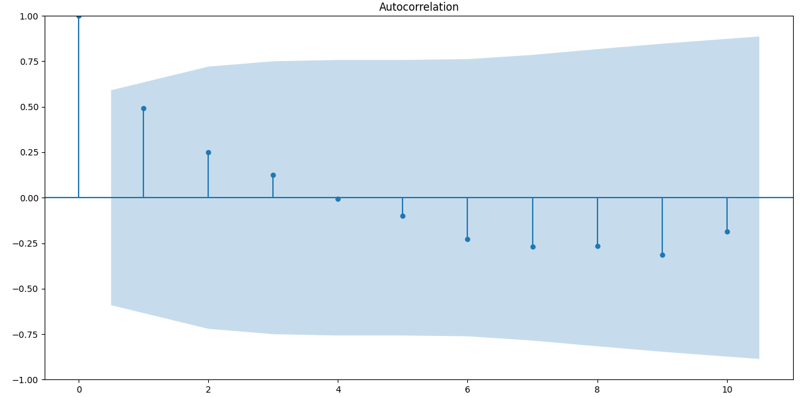
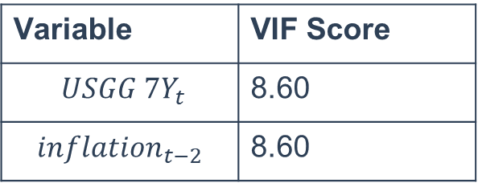
Model (2), Robust check
TEST | Score
Normality – Jarque-Berra test | P-value = 0.45 (Ho = Normal distribution)
Variance – Breusch-Pagan test | P-value = 0.84 (Ho = Constant variance)
Variable | VIF Score
$${ USGG 7Y}_{t}$$ | 8.60
$$inflation_{t−2}$$ | 8.60
Multicollinearity threshold is based on KPMG’s threshold (VIF < 10)

Slide 12
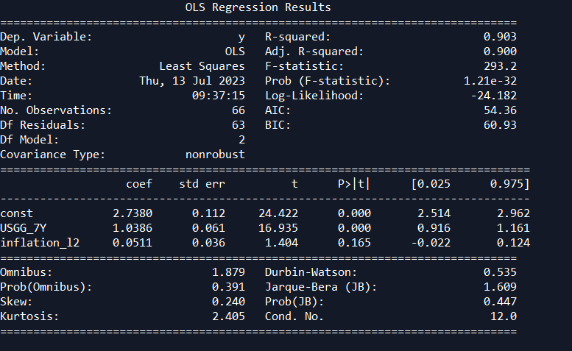
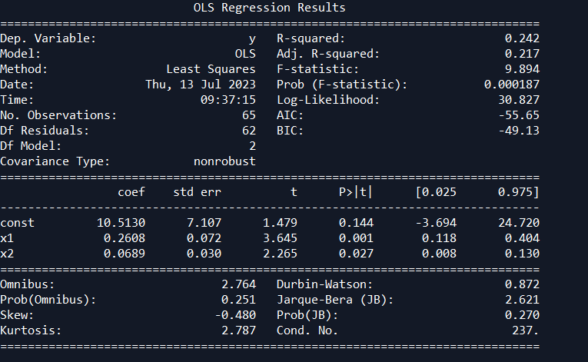
Model (3)
Initial OLS result
OLS result after Cochrane-Orcutt Procedure

Slide 13
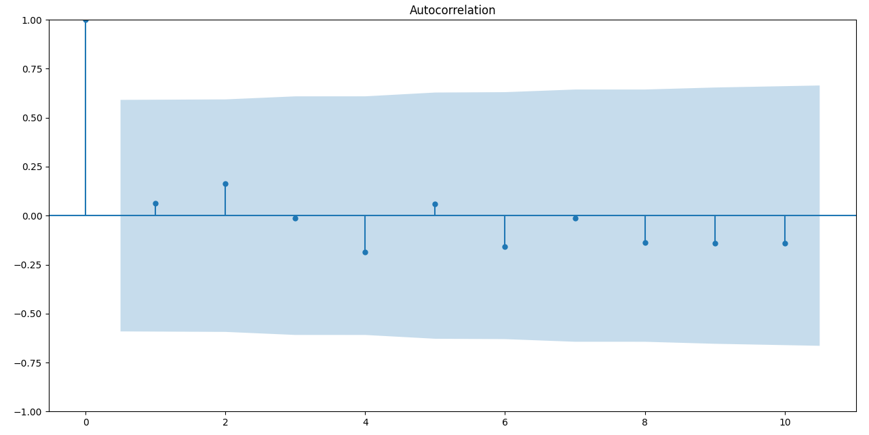
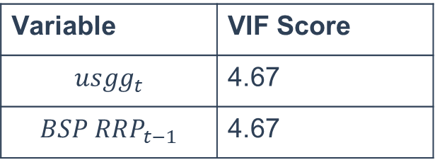
Model (3), Robust check
TEST | Score
Normality – Shapiro-wilk test | P-value = 0.06 (Ho = Normal distribution)
Variance – Breusch-Pagan p-value | P-value = 0.40 (Ho = Constant variance)
Variable | VIF Score
$$usgg_{t}$$ | 4.67
$$BSP RRP_{t−1}$$ | 4.67
Multicollinearity threshold is based on KPMG’s threshold (VIF < 10)

Slide 14
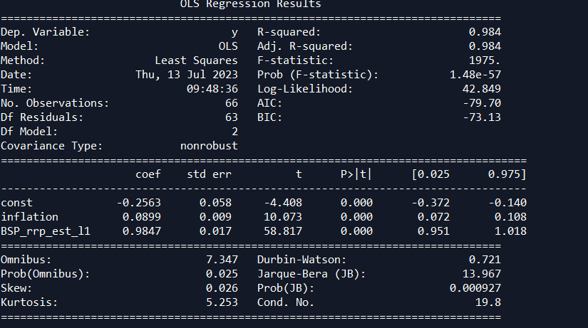
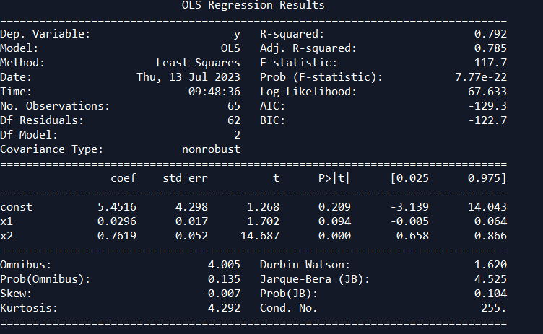
Model (3)
Initial OLS result
OLS result after Cochrane-Orcutt Procedure

